Slide 1
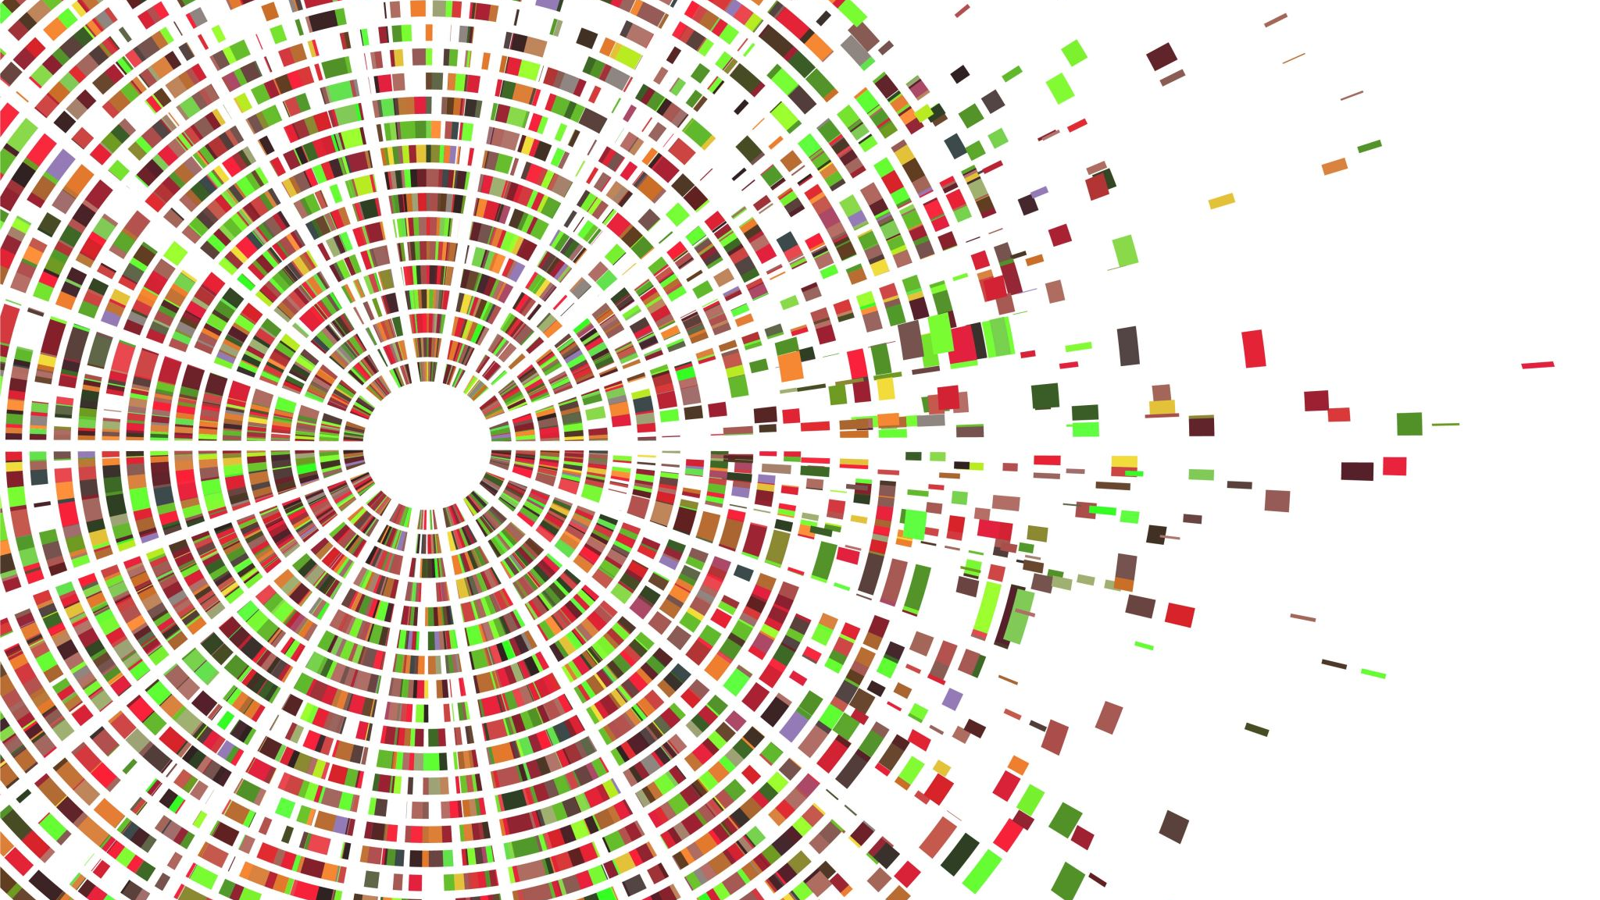
The Rise of Fake News in the Political Scene
By Michael Mahoney

Slide 2

Presentation Overview

Slide 3

Who is This Presentation For

Slide 4

Misinformation
False is easyish
True is less easy
Anything else is hard

Slide 5
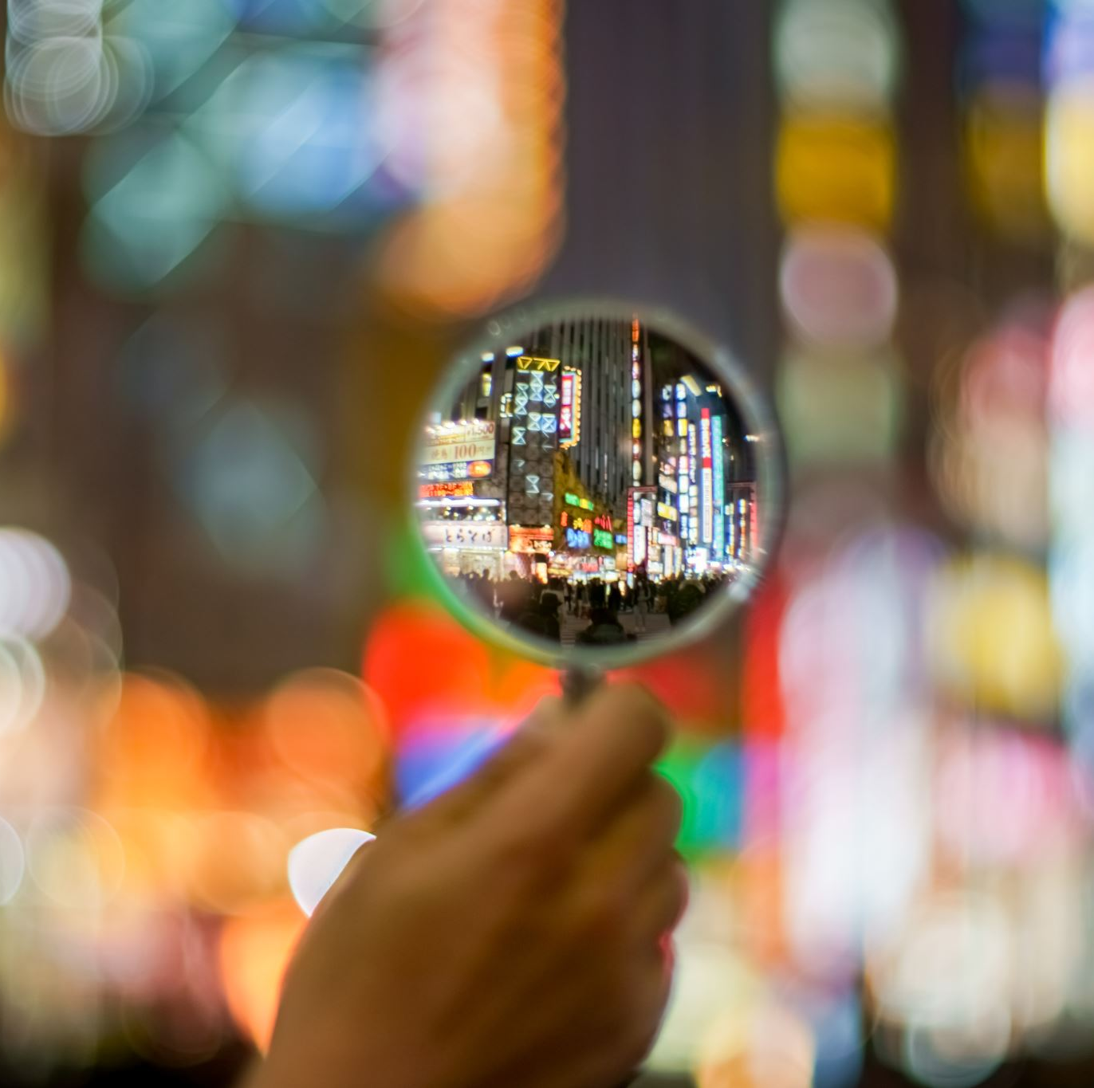
What to do about it

Slide 6

Future Work

Slide 7
Thank you

